Slide 1
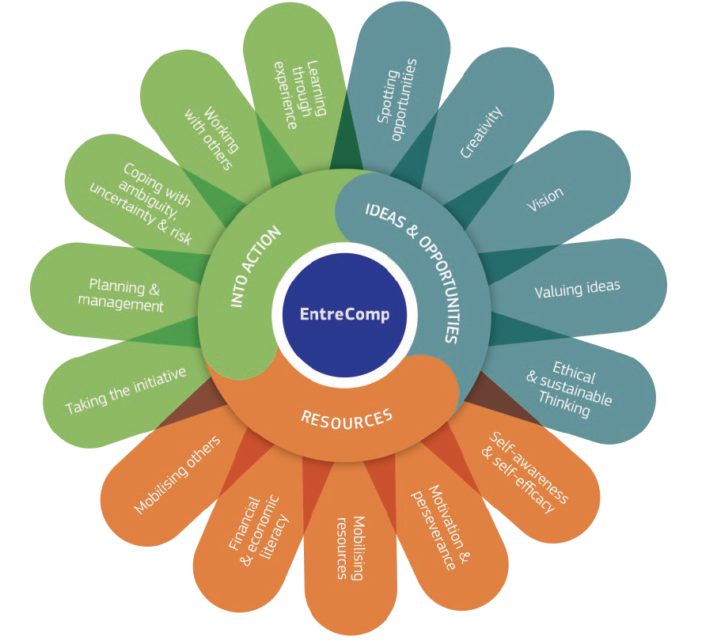
2.5 Mobilitare gli altri
2.5.A Convincere attraverso entusiasmo ed ispirazione
This project has been funded with support from the European Commission. This document and its contents reflect the views only of the authors, and the Commission cannot be held responsible for any use which may be made of the information contained therein​
Legal description – Creative Commons licensing: The materials published on the EntreComp project website are classified as Open Educational Resources' (OER) and can be freely (without permission of their creators): downloaded, used, reused, copied, adapted, and shared by users, with information about the source of their origin.

Slide 2
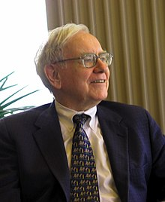
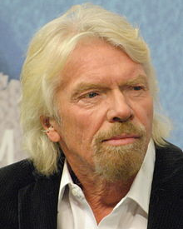
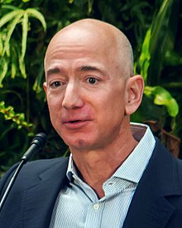
Imprenditori Oggi
…di successo, innovative e convincenti
Mark Zuckerberg
(Facebook)
Elon Musk
(Tesla)
Warren Buffet
(Berkshire Hathaway)
Your local
“hero”
Bill Gates
(Microsoft)
Richard Branson
(Virgin)
Jeff Bezos
(Amazon)
Pictures from © www.Wikipedia.de
This project has been funded with support from the European Commission. This document and its contents reflect the views only of the authors, and the Commission cannot be held responsible for any use which may be made of the information contained therein​
Legal description – Creative Commons licensing: The materials published on the EntreComp project website are classified as Open Educational Resources' (OER) and can be freely (without permission of their creators): downloaded, used, reused, copied, adapted, and shared by users, with information about the source of their origin.

Slide 3
Una storia di successo
Cosa distingue I grandi imprenditori di successo?
Creatività
Passione e Entusiasmo (ispirazione)
Buona leadership
Apprendimento permanente
Competenza
Trasparenza
Eccellente comunicazione
Capacità di Innovare
Alto grado di convinzione
Social networking
Propensione al rischio
This project has been funded with support from the European Commission. This document and its contents reflect the views only of the authors, and the Commission cannot be held responsible for any use which may be made of the information contained therein​
Legal description – Creative Commons licensing: The materials published on the EntreComp project website are classified as Open Educational Resources' (OER) and can be freely (without permission of their creators): downloaded, used, reused, copied, adapted, and shared by users, with information about the source of their origin.

Slide 4
Il Convincimento fa la Differenza
Siamo tutti molto entusiasti da giovani
A giocare sulla sabbia
A suonare strumenti musicali
Andare al primo appuntamento
Come
???
Il Convincimento ha bisogno di vari strumenti
Il Convincimento significa essere entusiasti di:
Un nuovo prodotto
Una fantastica idea
Un nuovo design creato
Un processo di successo
Convinci i clienti ei nuovi imprenditori a lavorare sodo e con successo in una nuova attività
This project has been funded with support from the European Commission. This document and its contents reflect the views only of the authors, and the Commission cannot be held responsible for any use which may be made of the information contained therein​
Legal description – Creative Commons licensing: The materials published on the EntreComp project website are classified as Open Educational Resources' (OER) and can be freely (without permission of their creators): downloaded, used, reused, copied, adapted, and shared by users, with information about the source of their origin.

Slide 5
12 Aspetti da considerare
Prenditi abbastanza tempo per parlare e discutere
Alto grado di accettazione di colleghi, partner, clienti
Sii aperto agli altri
Sii entusiasta usando esempi concreti
Abbi fiducia nelle collaborazioni
Sii orientato alla stima degli altri
Non aspettare troppo a lungo: agisci invece di reagire
Convincimento basato sull’Onestà
Capacità di ascolto
Cooperazione basata sull’Empatia
Non preoccuparti degli stakeholder
Rendi chiari I benefici
Aspettati dagli altri tanto quanto da te stesso
This project has been funded with support from the European Commission. This document and its contents reflect the views only of the authors, and the Commission cannot be held responsible for any use which may be made of the information contained therein​
Legal description – Creative Commons licensing: The materials published on the EntreComp project website are classified as Open Educational Resources' (OER) and can be freely (without permission of their creators): downloaded, used, reused, copied, adapted, and shared by users, with information about the source of their origin.

Slide 6
Gestire l’Entusiasmo
L'entusiasmo è fondamentale per il successo di una nuova impresa, ma può anche avere un effetti negativi.
Aspetti | Benefici | Inconvenienti
Percezione | Apertura a Nuove idee | Sopravvalutazione delle idee
Cognizione | Processo decisionale efficente | Attenzione Ridotta
Auto-regolamentazione | Adattabilità | Impulsività
Motivazione | Maggiore Energia, Confidenza | Sforzo Ridotto
MA
This project has been funded with support from the European Commission. This document and its contents reflect the views only of the authors, and the Commission cannot be held responsible for any use which may be made of the information contained therein​
Legal description – Creative Commons licensing: The materials published on the EntreComp project website are classified as Open Educational Resources' (OER) and can be freely (without permission of their creators): downloaded, used, reused, copied, adapted, and shared by users, with information about the source of their origin.

Slide 7
Le mie Capacità
Come sono entusiasta e convincente oggi?*
Cosa sta andando bene?
…
…
…
Cosa non sta andando bene?
…
…
…
Le mie conseguenze
…
…
…
*Il lettore dovrebbe prima rispondere alle due domande in alto e in un terzo passaggio elencare le proprie conseguenze.
This project has been funded with support from the European Commission. This document and its contents reflect the views only of the authors, and the Commission cannot be held responsible for any use which may be made of the information contained therein​
Legal description – Creative Commons licensing: The materials published on the EntreComp project website are classified as Open Educational Resources' (OER) and can be freely (without permission of their creators): downloaded, used, reused, copied, adapted, and shared by users, with information about the source of their origin.

Slide 8
Step per essere convincenti
Inizia lavorando su te stesso
Non avere paura di perdere
…
…
Sii convinto della tua Idea
Sii realistico
Considera la comunicazione non-verbale
Ascolta il tuo partner
Reference: Top Tagungszentrum AG, www.top-tagung.de/blog/wie-ueberzeige-ich-menschen/
This project has been funded with support from the European Commission. This document and its contents reflect the views only of the authors, and the Commission cannot be held responsible for any use which may be made of the information contained therein​
Legal description – Creative Commons licensing: The materials published on the EntreComp project website are classified as Open Educational Resources' (OER) and can be freely (without permission of their creators): downloaded, used, reused, copied, adapted, and shared by users, with information about the source of their origin.

Slide 9
Motivazione da parte del team leader
I Team leader sono responsabili per:
Motivare il team
Assicurare un livello appropriato di Entusiasmo
Conoscere gli strumenti giusti per questo processo, ad es. team building
Conoscere i passi giusti per motivare e ispirare i membri del team
This project has been funded with support from the European Commission. This document and its contents reflect the views only of the authors, and the Commission cannot be held responsible for any use which may be made of the information contained therein​
Legal description – Creative Commons licensing: The materials published on the EntreComp project website are classified as Open Educational Resources' (OER) and can be freely (without permission of their creators): downloaded, used, reused, copied, adapted, and shared by users, with information about the source of their origin.

Slide 10
La casa dell’Entusiasmo
Source: 1 © Dorr, d-ialogo, 2020
Metodo/ Attività
Discussioni Face to Face;
Usare argomenti onesti per convincere;
Usare esempi;
Sottolinea i vantaggi concreti del tuo aiuto.
Scopi
es.: per convincere i tuoi colleghi del giusto contenuto della proposta
Target group
Partner
Colleghi
Stakeholder
Amici
This project has been funded with support from the European Commission. This document and its contents reflect the views only of the authors, and the Commission cannot be held responsible for any use which may be made of the information contained therein​
Legal description – Creative Commons licensing: The materials published on the EntreComp project website are classified as Open Educational Resources' (OER) and can be freely (without permission of their creators): downloaded, used, reused, copied, adapted, and shared by users, with information about the source of their origin.

Slide 11
Guida per la casa dell’Entusiasmo
Definisci innanzitutto i tuoi principali target group
Formula almeno 3 obiettivi concreti per ogni Gruppo che vuoi raggiungere con le tue attività di entusiasmo;
Pensa a come ralizzare questi obiettivi: semplice, chiaro ed efficace
Nota bene: Ogni percorso va bene.E’ sempre una tua decisione personale il percorso che scegli.
This project has been funded with support from the European Commission. This document and its contents reflect the views only of the authors, and the Commission cannot be held responsible for any use which may be made of the information contained therein​
Legal description – Creative Commons licensing: The materials published on the EntreComp project website are classified as Open Educational Resources' (OER) and can be freely (without permission of their creators): downloaded, used, reused, copied, adapted, and shared by users, with information about the source of their origin.

Slide 12
2.5 Mobilitare gli Altri
2.5.B Comunicazione: efficace, orientata ai media e sostenibile
This project has been funded with support from the European Commission. This document and its contents reflect the views only of the authors, and the Commission cannot be held responsible for any use which may be made of the information contained therein​
Legal description – Creative Commons licensing: The materials published on the EntreComp project website are classified as Open Educational Resources' (OER) and can be freely (without permission of their creators): downloaded, used, reused, copied, adapted, and shared by users, with information about the source of their origin.

Slide 13
Cos’è la comunicazione?
Scambio di informazioni tra persone
Scambio tramite lingua e simboli
…
…
La comunicazione può essere realizzata con grande consapevolezza ma anche inconsciamente
Buona connessione tra trasmettitore e ricevitore
La comunicazione necessita di almeno due persone che prendano parte al processo
La Comunicazione è alla base per l’entusiasmo
E’ alla base per vivere insieme
Source: https://www.studienkreis.de/deutsch/kommunikation-ueberblick/
This project has been funded with support from the European Commission. This document and its contents reflect the views only of the authors, and the Commission cannot be held responsible for any use which may be made of the information contained therein​
Legal description – Creative Commons licensing: The materials published on the EntreComp project website are classified as Open Educational Resources' (OER) and can be freely (without permission of their creators): downloaded, used, reused, copied, adapted, and shared by users, with information about the source of their origin.

Slide 14
Una comunicazione di successo:
Quando?
Ci fidiamo dell’altra parte;
I concetti sono definiti in maniera chiara
La conversazione è ben preparata
La cooperazione con l’altra persona è basata sulla partnership
Si usa un linguaggio semplice
Si cerca di essere breve nella Conversazione
Non si interrompe il partner
Diciamo la verità e siamo credibili
Fonte: https://zeitzuleben.de/kommunikation/; https://www.zielbar.de/magazine/bessere-interne-Kommunikation-23585/
This project has been funded with support from the European Commission. This document and its contents reflect the views only of the authors, and the Commission cannot be held responsible for any use which may be made of the information contained therein​
Legal description – Creative Commons licensing: The materials published on the EntreComp project website are classified as Open Educational Resources' (OER) and can be freely (without permission of their creators): downloaded, used, reused, copied, adapted, and shared by users, with information about the source of their origin.

Slide 15
Il processo della comunicazione
Mittente (idee)
Segnali
Ricevitore (significato)
Messaggi (codificare)
Recipienti (decifrare)
Feedback
Fonte: Die 6 Phasen im Kommunikationsprozess www.userlike.com
This project has been funded with support from the European Commission. This document and its contents reflect the views only of the authors, and the Commission cannot be held responsible for any use which may be made of the information contained therein​
Legal description – Creative Commons licensing: The materials published on the EntreComp project website are classified as Open Educational Resources' (OER) and can be freely (without permission of their creators): downloaded, used, reused, copied, adapted, and shared by users, with information about the source of their origin.

Slide 16
Ispirare gli altri…
Combina le tue attività con quelle di pubbliche relazioni
Buona comunicazione significa comunicazione attiva
Partecipazione da supporto di esperti esterni
La decisione sul giusto canale di comunicazione dipende dal gruppo target
La comunicazione necessita di vantaggi descritti chiaramente
Convinzione attraverso l’obiettività
This project has been funded with support from the European Commission. This document and its contents reflect the views only of the authors, and the Commission cannot be held responsible for any use which may be made of the information contained therein​
Legal description – Creative Commons licensing: The materials published on the EntreComp project website are classified as Open Educational Resources' (OER) and can be freely (without permission of their creators): downloaded, used, reused, copied, adapted, and shared by users, with information about the source of their origin.

Slide 17
Mobilitare la conoscenza di sè
Comunica in maniera chiara
Usa tutte le tue possibilità per ottenere feedback
Sii sempre critico nei tuoi confronti
Come usi l’espressione facciale??
E il tuo linguaggio del corpo?
Rifletti sulla tua ultima conversazione!
Trova 3 attività che creano:
Impressioni negative
…
…
…
Impressioni positive
…
…
…
Source: https://link.springer.com/chapter/10.1007/978-3-322-83511-6_10; https://www.fuer-gruender.de/wiisen/unternehmen-gruenden/aussenauftritt/Kommunikation; https://www.sputnik-agentur.de/blog/10-dinge-die-sie-tun-koennen-um-ihre-interne-kommunikation-zu-verbessern/
This project has been funded with support from the European Commission. This document and its contents reflect the views only of the authors, and the Commission cannot be held responsible for any use which may be made of the information contained therein​
Legal description – Creative Commons licensing: The materials published on the EntreComp project website are classified as Open Educational Resources' (OER) and can be freely (without permission of their creators): downloaded, used, reused, copied, adapted, and shared by users, with information about the source of their origin.

Slide 18
6 errori comuni nella comunicazione
Essere focalizzati su se stessi
La conversazione è monotona
Le tue aspettative sul contenuto sono sbagliate
Parlare della cosa sbagliata
equilibrio scoretto tra parlare e ascoltare
Conoscere tutto meglio dell’altro
Fonte: https://kommunikation-lernen.de/wp-content/uploads/2018/12/Smalltalk-Infografik.png; https://www.zeitblueten.com/news/interne-kommunikaton/
This project has been funded with support from the European Commission. This document and its contents reflect the views only of the authors, and the Commission cannot be held responsible for any use which may be made of the information contained therein​
Legal description – Creative Commons licensing: The materials published on the EntreComp project website are classified as Open Educational Resources' (OER) and can be freely (without permission of their creators): downloaded, used, reused, copied, adapted, and shared by users, with information about the source of their origin.

Slide 19
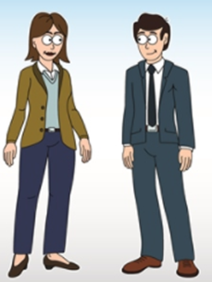
Consigli per una Buona Comunicazione
Continua a gestire la conversazione
le discussioni dovrebbero essere entusiasmanti
E’ importante iniziare bene la conversazione
Praticare la vita quotidiana può essere utile
Avere una buona conoscenza dell’oggetto della conversazione
Guarda il tuo partner
Fonte : https://kommunikation-lernen.de/wp-content/uploads/2018/12/Smalltalk-Infografik.png; https://www.zeitblueten.com/news/interne-kommunikaton/; http://blog.dgq.de/
This project has been funded with support from the European Commission. This document and its contents reflect the views only of the authors, and the Commission cannot be held responsible for any use which may be made of the information contained therein​
Legal description – Creative Commons licensing: The materials published on the EntreComp project website are classified as Open Educational Resources' (OER) and can be freely (without permission of their creators): downloaded, used, reused, copied, adapted, and shared by users, with information about the source of their origin.

Slide 20
Comunicazione Online
Per utilizzare la comunicazione online hai bisogno di conoscere:
Le aspettative del partner
I Bisogni del target group
Caratteristiche e Pecularietà
Nota Bene: hai bisogno di molte esperienze per decidere quale canale di comunicazione è il più adatto per ogni target group
Fonte: https://www.kompetenzzentrum-kommunikation.de/artikel/was-macht-gute-onlinekommunikation-aus-2707/; https://interne-kommunikation.net/interne-kommunikation-2019-das-sind-die-top-5-trends/; https://www.ik-up-de/blog/interne-kommunikation-diese-trends-solltest-du-kennen
This project has been funded with support from the European Commission. This document and its contents reflect the views only of the authors, and the Commission cannot be held responsible for any use which may be made of the information contained therein​
Legal description – Creative Commons licensing: The materials published on the EntreComp project website are classified as Open Educational Resources' (OER) and can be freely (without permission of their creators): downloaded, used, reused, copied, adapted, and shared by users, with information about the source of their origin.

Slide 21
Comunicazione F2F & Online
In base al tipo di comunicazione che scegli, l’altra parte avrà diverse al tuo messaggio reazioni
Nella comunicazione Face-to-Face (F2F) puoi:
Nella comunicazione online puoi::
Leggere il linguaggio del corpo
Evitare fraintendimenti
Scoprire le prospettive dei tuoi clienti
Ottenere feedback onesti
Interagire in maniera flessibile, veloce e in modo conveniente
Mezzi di comunicazione online: E-mails, Online Forms, Forum, Social Network, Blog, Messaggistica istantanea
Fonte: https://www.kompetenzzentrum-kommunikation.de/artikel/was-macht-gute-onlinekommunikation-aus-2707/; https://interne-kommunikation.net/interne-kommunikation-2019-das-sind-die-5-top-trends/; https://www.ik-up.de/blog/interne-kommunikation-diese-trends-solltest-du-kennen
This project has been funded with support from the European Commission. This document and its contents reflect the views only of the authors, and the Commission cannot be held responsible for any use which may be made of the information contained therein​
Legal description – Creative Commons licensing: The materials published on the EntreComp project website are classified as Open Educational Resources' (OER) and can be freely (without permission of their creators): downloaded, used, reused, copied, adapted, and shared by users, with information about the source of their origin.

Slide 22
Quale scegliere?
Dovrei scegliere la comunicazione Online o Offline
Online, quando…. | Offline, quando…
- Desideri flessibilità | - Desideri una risposta diretta dall’altra parte
- Desideri raggiungere un ampio pubblico | - Desideri costruire una relazione forte e rispettosa
- Sei in situazioni di urgenza | - Hai bisogno di franchezza e immediatezza
Kupritz, V. W., & Cowell, E. (2011). Productive management communication: Online and face-to-face.
This project has been funded with support from the European Commission. This document and its contents reflect the views only of the authors, and the Commission cannot be held responsible for any use which may be made of the information contained therein​
Legal description – Creative Commons licensing: The materials published on the EntreComp project website are classified as Open Educational Resources' (OER) and can be freely (without permission of their creators): downloaded, used, reused, copied, adapted, and shared by users, with information about the source of their origin.

Slide 23
2.5 Mobilitare gli altri
2.5.C Persuadere e ispirare gli altri nelle attività di creazione di valore
This project has been funded with support from the European Commission. This document and its contents reflect the views only of the authors, and the Commission cannot be held responsible for any use which may be made of the information contained therein​
Legal description – Creative Commons licensing: The materials published on the EntreComp project website are classified as Open Educational Resources' (OER) and can be freely (without permission of their creators): downloaded, used, reused, copied, adapted, and shared by users, with information about the source of their origin.

Slide 24
Cos’è la Persuasione?
La persuasione è un'attività che crea valore. Ad esempio, nel business consiste nella vendita o nel commercio di un prodotto aziendale, al fine di ottenere un profitto.
Ma cosa significa persuadere e ispirare gli altri nelle tue attività di creazione di valore?
Vuol dire condividere la tua idea, con passione. Questo ispirerà anche gli altri a credere e sostenere la tua idea.
This project has been funded with support from the European Commission. This document and its contents reflect the views only of the authors, and the Commission cannot be held responsible for any use which may be made of the information contained therein​
Legal description – Creative Commons licensing: The materials published on the EntreComp project website are classified as Open Educational Resources' (OER) and can be freely (without permission of their creators): downloaded, used, reused, copied, adapted, and shared by users, with information about the source of their origin.

Slide 25
Il processo di Persuasione
Il Processo di persuasione inizia con una convinta presentazione della tua idea. Cerca di comprendere le emozioni del tuo ascoltatore e ispiralo a essere coinvolto nella tua idea
Proponi la tua idea in modo efficace
Crea una “call of action” per coinvolgerli
Negozia il support per la tua idea
Tocca le loro emozioni
This project has been funded with support from the European Commission. This document and its contents reflect the views only of the authors, and the Commission cannot be held responsible for any use which may be made of the information contained therein​
Legal description – Creative Commons licensing: The materials published on the EntreComp project website are classified as Open Educational Resources' (OER) and can be freely (without permission of their creators): downloaded, used, reused, copied, adapted, and shared by users, with information about the source of their origin.

Slide 26
Come persuadere gli altri?
Per ispirare con successo gli altri, devi seguire il Processo di Persuasione in 4 fasi:
4. Risultato
3. Presentazione
2. Preparazione
1. Fondamenta
Non dimenticare:
La tua passione porta le persone a dare fiducia alla tua idea
Hogan (2010). The psychology of persuasion: how to persuade others to your way of thinking.
This project has been funded with support from the European Commission. This document and its contents reflect the views only of the authors, and the Commission cannot be held responsible for any use which may be made of the information contained therein​
Legal description – Creative Commons licensing: The materials published on the EntreComp project website are classified as Open Educational Resources' (OER) and can be freely (without permission of their creators): downloaded, used, reused, copied, adapted, and shared by users, with information about the source of their origin.

Slide 27
Step 1: Fondamenta
Preparati ad attrarre il tuo gruppo target verso la tua idea.
3 fattori di successo:
Mentalità Vincente
Passione
Condivisione della Passione
5 parole persuasive da usare:
Per questo motivo
Nuovo/ Innovativo
Immagina che..
Tu
Segreto
Starbucks esprime la sua passione per la creazione di un luogo in cui le persone possano rilassarsi e connettersi
This project has been funded with support from the European Commission. This document and its contents reflect the views only of the authors, and the Commission cannot be held responsible for any use which may be made of the information contained therein​
Legal description – Creative Commons licensing: The materials published on the EntreComp project website are classified as Open Educational Resources' (OER) and can be freely (without permission of their creators): downloaded, used, reused, copied, adapted, and shared by users, with information about the source of their origin.

Slide 28
Step 2: Preparazione
Sii perfettamente preparato. 5 attività di preparazione:
Analizza il tuo pubblico
Stabilisci un obiettivo
Raccogli informazioni
Codifica il tuo messaggio
Pratica
Esercizi diBrainstorming
Trova altre 5 attività di preparazione
This project has been funded with support from the European Commission. This document and its contents reflect the views only of the authors, and the Commission cannot be held responsible for any use which may be made of the information contained therein​
Legal description – Creative Commons licensing: The materials published on the EntreComp project website are classified as Open Educational Resources' (OER) and can be freely (without permission of their creators): downloaded, used, reused, copied, adapted, and shared by users, with information about the source of their origin.

Slide 29
Step 3: Presentazione
Trasmetti il messaggio!
Scegli Materiali emozionanti
Crea uno schema di parole chiave
Usa un linguaggio del corpo corretto
Mantieni il contatto visivo
Mostra urgenza. Perché hanno bisogno di agire ora
This project has been funded with support from the European Commission. This document and its contents reflect the views only of the authors, and the Commission cannot be held responsible for any use which may be made of the information contained therein​
Legal description – Creative Commons licensing: The materials published on the EntreComp project website are classified as Open Educational Resources' (OER) and can be freely (without permission of their creators): downloaded, used, reused, copied, adapted, and shared by users, with information about the source of their origin.

Slide 30
Migliorare la capacità di negoziazione
Comunicazione verbale efficace
Ascolta
Stabilisci una connessione
Problem Solving
Prendi una decisione
This project has been funded with support from the European Commission. This document and its contents reflect the views only of the authors, and the Commission cannot be held responsible for any use which may be made of the information contained therein​
Legal description – Creative Commons licensing: The materials published on the EntreComp project website are classified as Open Educational Resources' (OER) and can be freely (without permission of their creators): downloaded, used, reused, copied, adapted, and shared by users, with information about the source of their origin.

Slide 31
La pratica rende perfetti
Seguendo i 4 passaggi della persuasione, crea una presentazione di 5 minuti di un'idea imprenditoriale di cui sei appassionato. L'obiettivo di questa presentazione è convincere un investitore a finanziare la tua idea
Step 1: Introduci la tua idea usando le 5 parole persuasive;
Step 2: Prepara il tuo materiale. S.g. Qual è l’obiettivo?Usa due delle attività di preparazione che ti sono venute in mente.
Step 3: Pratica la tua presentazione. Es. Quale sarà il tuo linguaggio del corpo?
Step 4: Come interagirai meglio con l'investitore?
This project has been funded with support from the European Commission. This document and its contents reflect the views only of the authors, and the Commission cannot be held responsible for any use which may be made of the information contained therein​
Legal description – Creative Commons licensing: The materials published on the EntreComp project website are classified as Open Educational Resources' (OER) and can be freely (without permission of their creators): downloaded, used, reused, copied, adapted, and shared by users, with information about the source of their origin.

Slide 32
Riepilogo: Checklist per il self-check
Qual è un elemento importante per diventare imprenditore?
Gli aspetti per essere entusiasti!
Descrivi 2 step per essere perfetto nel convincimento!
Cos’è la “Casa dell’Entusiasmo”?
In quali circostanze la comunicazione ha successo?
This project has been funded with support from the European Commission. This document and its contents reflect the views only of the authors, and the Commission cannot be held responsible for any use which may be made of the information contained therein​
Legal description – Creative Commons licensing: The materials published on the EntreComp project website are classified as Open Educational Resources' (OER) and can be freely (without permission of their creators): downloaded, used, reused, copied, adapted, and shared by users, with information about the source of their origin.

Slide 33
Riepilogo: Checklist per il self-check
Descrivi il processo della comunicazione!
Quali sono gli errori comuni nella comunicazione?
Identifica le tue idee per una comunicazione Online!
Quali sono gli elementi base del processo persuasivo?
Descrivi I 4 step per persuadere gli altri!
This project has been funded with support from the European Commission. This document and its contents reflect the views only of the authors, and the Commission cannot be held responsible for any use which may be made of the information contained therein​
Legal description – Creative Commons licensing: The materials published on the EntreComp project website are classified as Open Educational Resources' (OER) and can be freely (without permission of their creators): downloaded, used, reused, copied, adapted, and shared by users, with information about the source of their origin.

